Slide 1
Capstone Project week 2
FINALE

Slide 2
BACKGROUND
The london housing market is in a rut.
Facing possible higher taxes
the bank of england that U.K. Home values could fall as much as 30 percent in the event of a disorderly exit from the european union.
hidden price falls, record-low sales, homebuilder exodus and tax hikes addressing overseas buyers of homes in england and wales.

Slide 3
Business problem
The need for homebuyers clientele in London to make wise and effective decisions.
how could we provide support to homebuyers clientele in to purchase a suitable real estate in London in this uncertain economic and financial scenario?
To solve this business problem,
we are going to cluster London neighbourhoods in order to recommend venues
the current average price of real estate where homebuyers can make a real estate investment.
Recommendation: We will recommend profitable venues according to amenities and essential facilities surrounding such venues i.e. elementary schools, high schools, hospitals & grocery stores.

Slide 4
Data section
Data on London properties and the relative price paid data were extracted from the HM Land Registry (http://landregistry.data.gov.uk/).
To explore and target recommended locations across different venues according to the presence of amenities and essential facilities,
we will access data through FourSquare API interface and arrange them as a dataframe for visualization.
By merging data on London properties and the relative price paid data from the HM Land Registry and data on amenities and essential facilities surrounding such properties from FourSquare API interface, we will be able to recommend profitable real estate investments.

Slide 5
Methodology section
Four stages:
1. Collect Inspection Data
2. Explore and Understand Data
3. Data preparation and preprocessing
4. Modelling

Slide 6
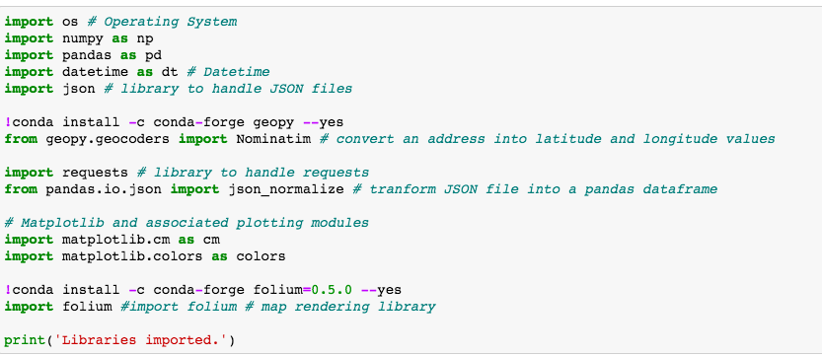
Methodology section I
1. Collect Inspection Data
After importing the necessary libraries, we download the data from the HM Land Registry website as follows:

Slide 7
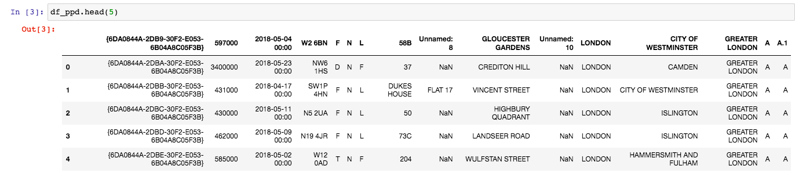
Methodology section II
EXPLORE AND UNDERSTAND DATA
We read the dataset that we collected from the HM Land Registry website into a pandas' data frame and display the first five rows of it as follows:

Slide 8
Methodology section III
DATA PREPARATION
At this stage, we prepare our dataset for the modeling process, opting for the most suitable machine learning algorithm for our scope. Accordingly, we perform the following steps:
Rename the column names
Format the date column
Sort data by date of sale
Select data only for the city of London
Make a list of street names in London
Calculate the street-wise average price of the property
Read the street-wise coordinates into a data frame, eliminating recurring word London from individual names
Join the data to find the coordinates of locations which fit into client's budget
Plot recommended locations on London map along with current market prices

Slide 9
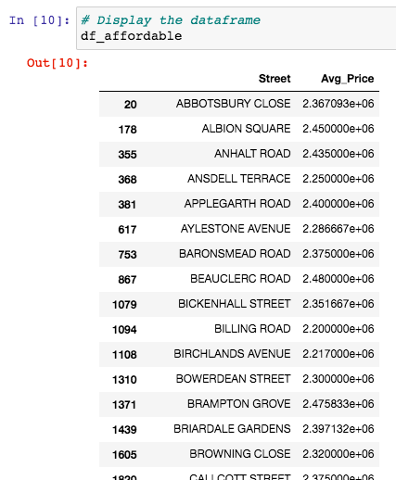
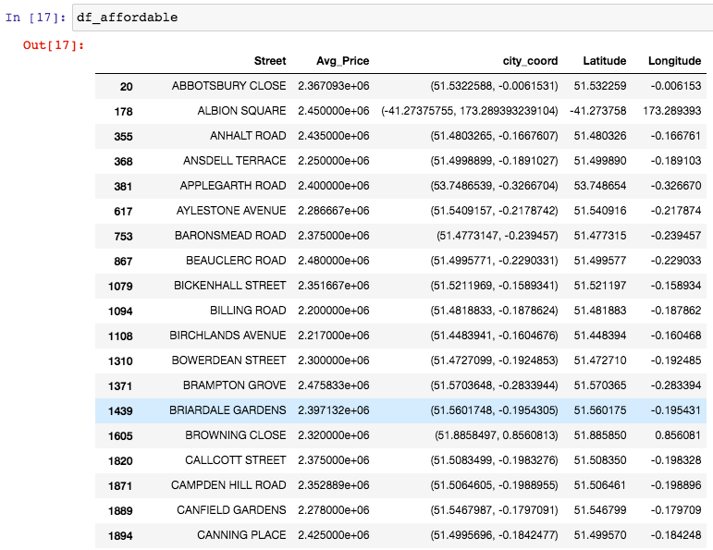
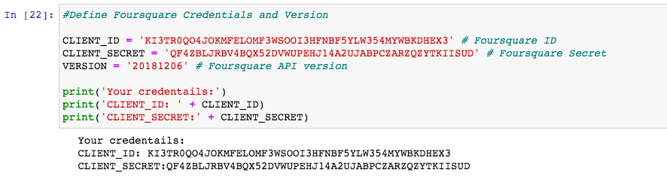
Methodology section III
DATA PREPARATION

Slide 10
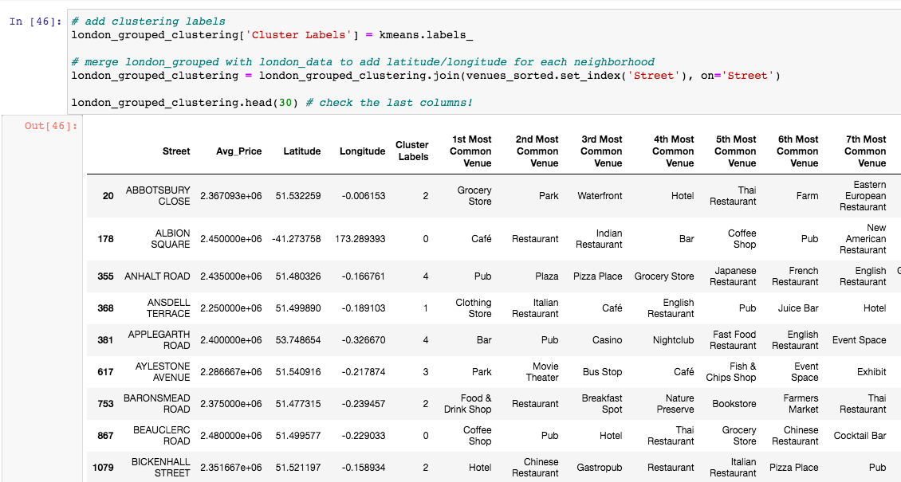
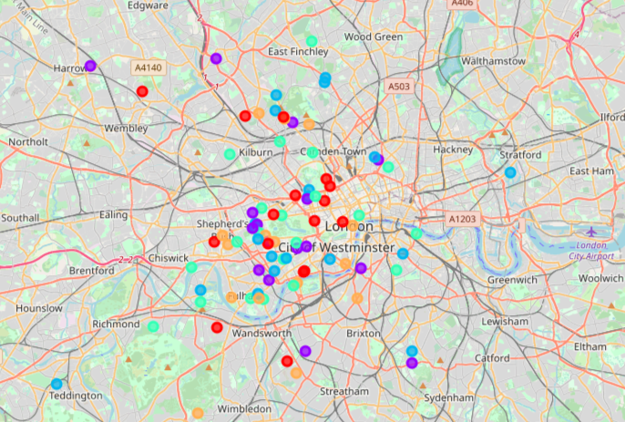
Methodology section IV
MODELLING
After exploring the dataset and gaining insights into it, we are ready to use the clustering methodology to analyze real estates. We will use the k-means clustering technique as it is fast and efficient in terms of computational cost, is highly flexible to account for mutations in real estate market in London and is accurate.

Slide 11
RESULTS & Discussion
It is interesting to note that, although West London (Notting Hill, Kensington, Chelsea, Marylebone) and North-West London (Hampsted) might be considered highly profitable venues to purchase a real estate according to amenities and essential facilities surrounding such venues i.e. elementary schools, high schools, hospitals & grocery stores,
South-West London (Wandsworth, Balham) and North-West London (Isliington) are arising as next future elite venues with a wide range of amenities and facilities. Accordingly, one might target under-priced real estates in these areas of London in order to make a business affair.
2. Second, we may analyze our results according to the five clusters we have produced.
Even though, all clusters could praise an optimal range of facilities and amenities, we have found two main patterns.
The first pattern we are referring to, i.e. Clusters 0, 2 and 4, may target home buyers prone to live in 'green' areas with parks, waterfronts.
Instead, the second pattern we are referring to, i.e. Clusters 1 and 3, may target individuals who love pubs, theatres and soccer.

Slide 12
COnclusion
it is still an "ever-green" for business.
We discussed our results under two main perspectives.
First, we examined them according to neighborhoods/London areas. although West London and North-West London might be considered highly profitable venues to purchase a real estate according to amenities and essential facilities surrounding such venues, South-West London and North-West London are arising as next future elite venues with a wide range of amenities and facilities.
Accordingly, one might target under-priced real estates in these areas of London in order to make a business affair.
Second, we analyzed our results according to the five clusters we produced. While Clusters 0, 2 and 4 may target home buyers prone to live in 'green' areas with parks, waterfronts, Clusters 1 and 3 may target individuals who love pubs, theatres and soccer.

